Slide 1

Hadoop Implementation for
Tumbhi
© Nihilent Technologies 2013

Slide 2
Agenda
Agenda
Overview of Hadoop : Introduction
Application Integration.
  Hadoop Implementation for Tumbhi.
- Tumbhi AS- IS
- Tumbhi with Hadoop.
- Architecture.
  Recommendation Algorithms/Collaborative filtering
- Algorithm Overview.
- Implementation.
Bigdata Integration and Reporting.
  Web Traffic reports.
- Architecture
- Reports.
Demo.
© Nihilent Technologies 2013

Slide 3
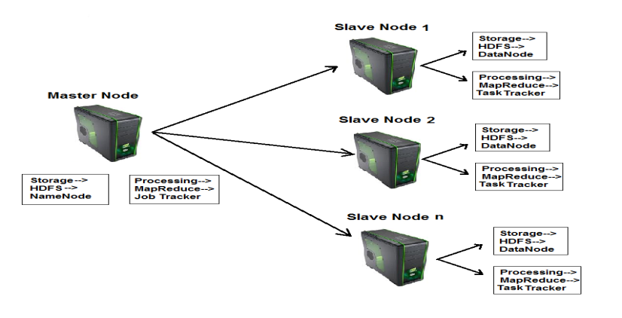
Agenda
Overview of Hadoop : Introduction
Hadoop is a framework that facilitates functioning of several machines together to achieve the goal of storage and analyzing large sets of data.
Hadoop makes data mining, analytics, and processing of
big data cheap and fast.
Hadoop consists of two core components
1. The Hadoop Distributed File System(HDFS)
- HDFS is responsible for storing data on
the cluster of machines.
- Data is normally split into 64MB to 128MB blocks and spread across the cluster.
2. MapReduce
      - MapReduce is data processing component of Hadoop.
      - Consist of two phases :
      1. Map
      2. Reduce
© Nihilent Technologies 2013

Slide 4
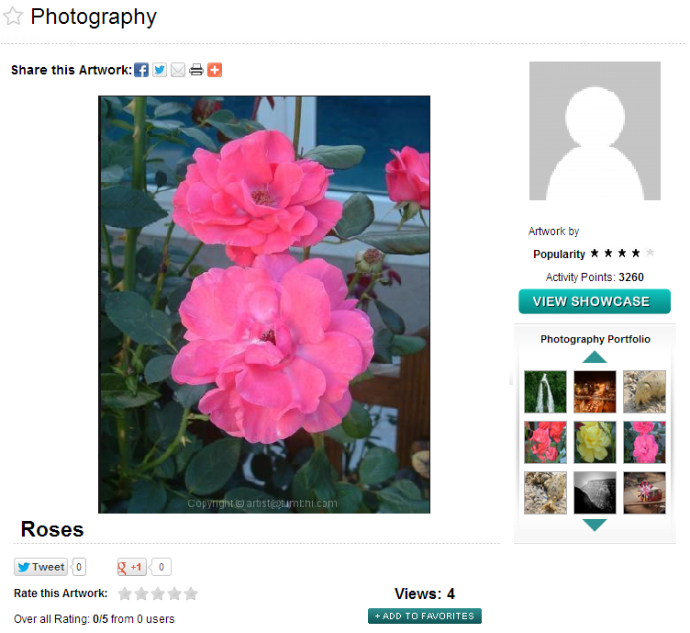
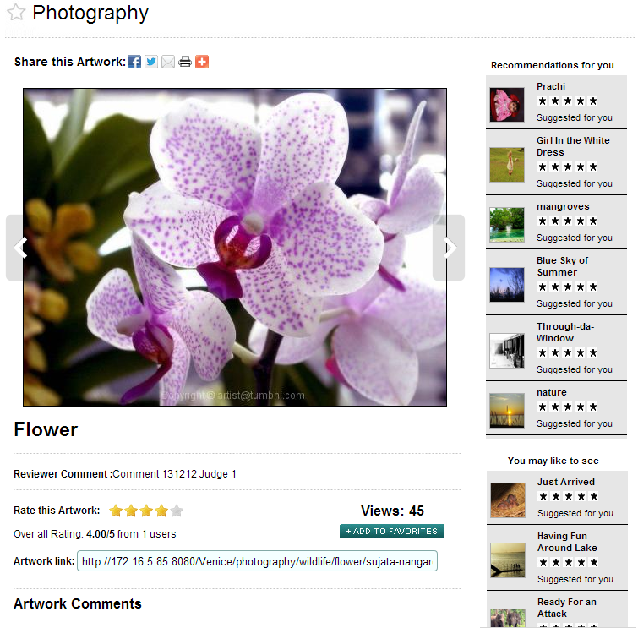
Tumbhi : Existing and Proposed
Proposed
Existing
© Nihilent Technologies 2013

Slide 5
Tumbhi : Existing and Proposed
 | Existing | Proposed
Recommendation Engine | No | Collaborative Filtering(User-user and Item-item) based Algorithms to give most likely recommendations.
Analytical Reporting | Google Analytics for reporting, but do not have customized reporting. | Hive-Pentaho integration for reports, can generate slandered as well as custom of report from the application logs and database tables.
Storage | MySQL Server (Structured), File Server, CDN, CMS (Unstructured) | Single source of storage(Structured + Unstructured). HDFS or MongoDB for structured and unstructured data, Hive for data warehousing and Reporting.
Search | Apache Solr on top of MySQL server. | MongoDB stores data with key value pairs, so searching is by default faster. Scale up to petabytes of data.
© Nihilent Technologies 2013

Slide 6
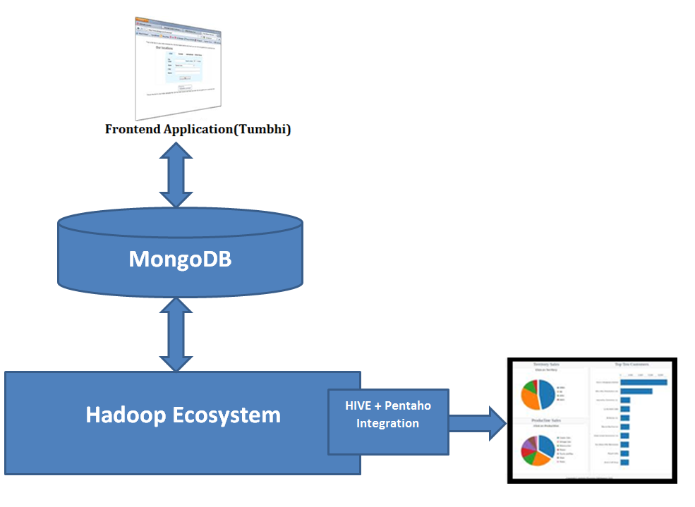
Hadoop Architecture :
MongoDB : Real-time integration
Pentaho : BI and Reporting
Hadoop Ecosystem : Data analysis,
Processing and Storage
© Nihilent Technologies 2013

Slide 7
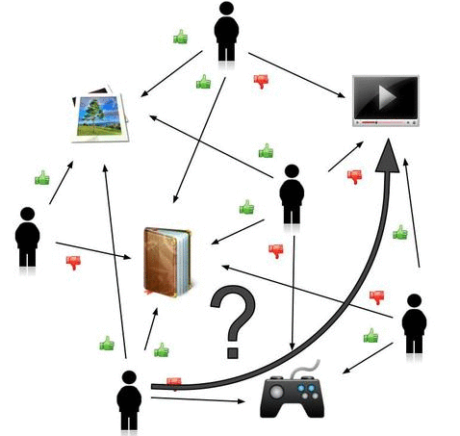
Recommendation Engine : Algorithms
Recommendations is all about predicting patterns of taste and using them to discover new and desirable things you didn’t already know about.
User-based Recommender
  Look to what people with similar seems to like
Item-based Recommender
  Figure out what items are like the once you already like, by looking into others’ apparent preferences.
Slope-One Recommender
  Look to what people and items with similar seems to
  Like(Most widely similar).
© Nihilent Technologies 2013

Slide 8
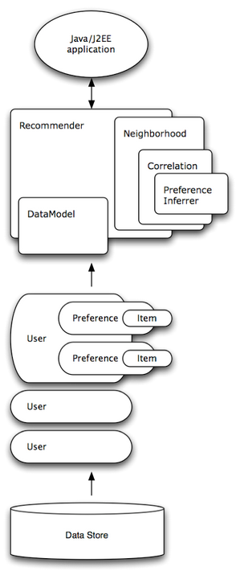
Recommendation Engine : Algorithm Overview
Application
Data model/Recommender
Preference calculation
Database
© Nihilent Technologies 2013

Slide 9
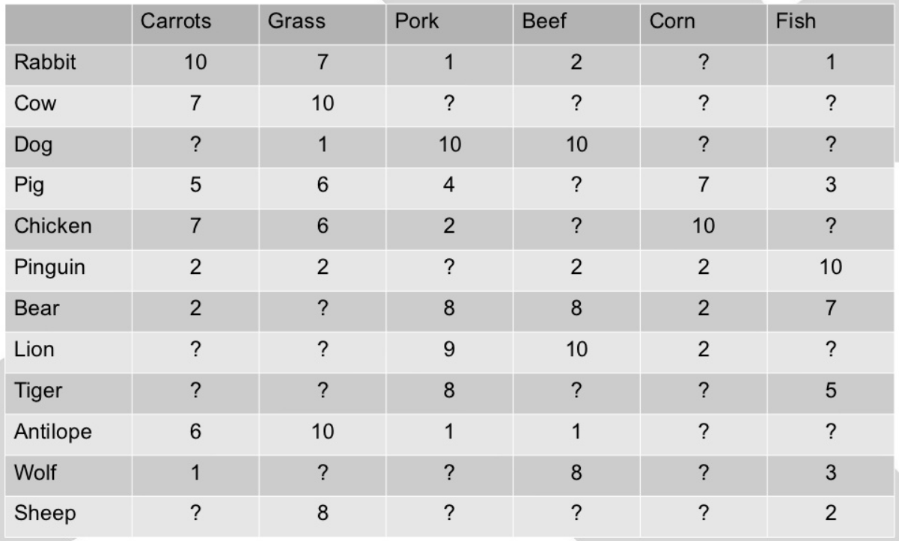
Demo Data:

Slide 10
Characteristics of Demo Data:
  Ratings form: 1-10
  Users: 12
  Items: 6
  Ratings: 43(unusual normally 100,000 – 100,000,000)
  Matrix Filled: ~60%
  Average Number Ratings per user: ~3.58
  Average Number Ratings per Item: ~7.17
  Average Ratings: ~5.59

Slide 11
User based Approach:
  - Find out similar or opposite animals like wolf.
  Checkout what these animals like
  Recommend this to wolf

Slide 12
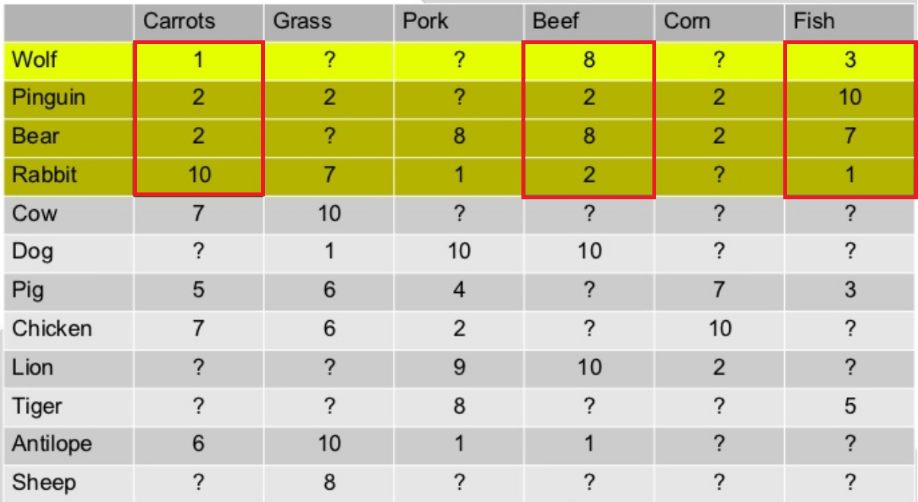
Grouping data:
Find the animals which voted for beef, fish and carrots too.

Slide 13
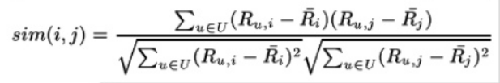
Pearson Correlation
1 = very similar voting.
(-1) = complete opposite voting.
Similarity between wolf and penguin: -0.2401922
  cor(c(8,3,1),c(2,10,2))
Similarity between wolf and bear: 0.8196562
  cor(c(8,3,1),c(8,7,2))
Similarity between wolf and rabbit: -0.6465846
  cor(c(8,3,1),c(2,1,10))

Slide 14
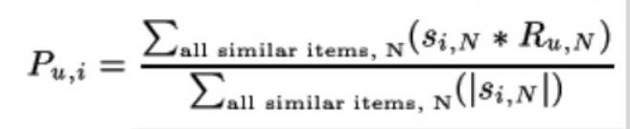
Weighted sum of ratings
Pork(10):
  ( 0.8196 * 8 + (-0.6466) * 1 ) / ( 0.8196 + (-0.6466) )
  = 34 ~ 10
Gross(5.65):
  ( (-0.2401) * 2 + (-0.6466) * 7 ) / ((-0.2401) + (-0.6466))
  =5.65
Corn(2.0)
  ( (-0.2401) * 2 + 0.8196 * 2) / ( (-0.2401) + 0.8196)
  =2.0

Slide 15
Predicted ratings
Wolf should eat : Pork ratings = 10.0
Wolf should eat : Grass ratings = 5.645701
Wolf should eat : Corn ratings = 2.0

Slide 16
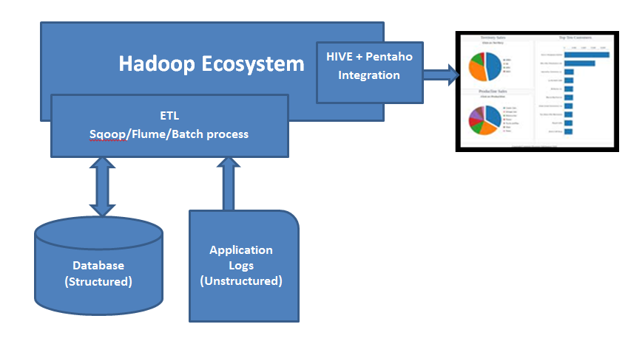
Bigdata Analytics :Web Traffic Reporting
Analytical reports from Application Logs(Unstructured data) and Database tables.
© Nihilent Technologies 2013

Slide 17
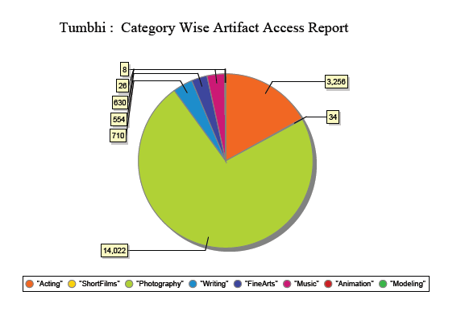
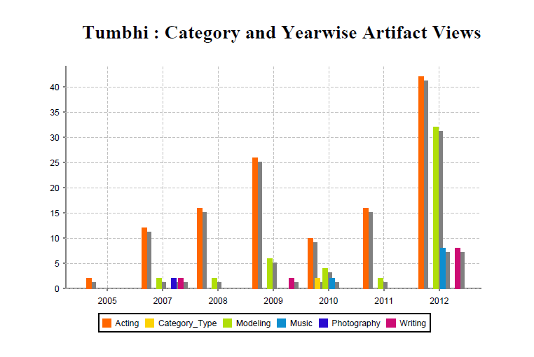
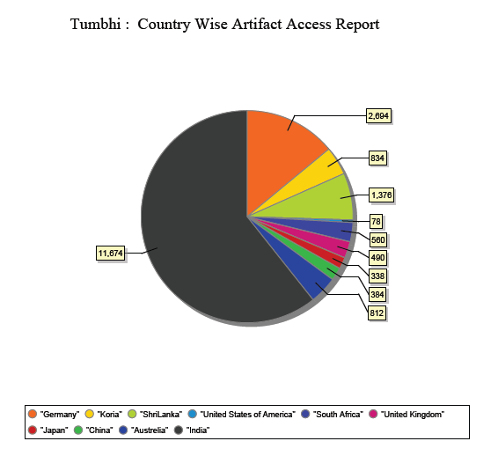
Web Traffic Reporting
© Nihilent Technologies 2013

Slide 18
Demo….
Application Integration.
  Recommendation(User and Item based) Example.
Bigdata Analytics and Reporting.
Analytical Reporting from Hive using Pentaho integration.
© Nihilent Technologies 2013

Slide 19
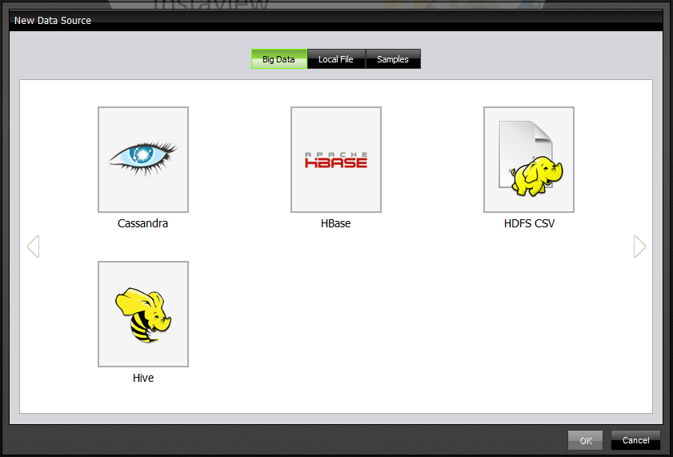
Research must go on….
Exploring Mahout(Machine Learning Library)
    Classification Algorithms
    Clustering Algorithms
    Recommendation on multiple dimensions : User-user recommendations (Facebook Friend Recommendations)
Hadoop Job scheduling and Automated processing with real time application.
Integration with social networks like twitter, Facebook, LinkedIn to generate the market survey.
Bigdata Analytical reporting using Pentaho Instaview templates.
    Pentaho connectivity with Multiple Hadoop Utilities.
© Nihilent Technologies 2013

Slide 20
Conclusion
Recommendations is lots of math, you shouldn’t implement the algorithms again use prebuilt libraries of mahout.
You can get lot a personalization from hadoop.
Hadoop is really a good solution for bigdata, not suitable for small data.
We are able to achieve a very good performance using scalable hadoop cluster environment.
Hadoop is not really real time, there is latency in response.
© Nihilent Technologies 2013

Slide 21
Thank you!
© Nihilent Technologies 2013

